Slide 1
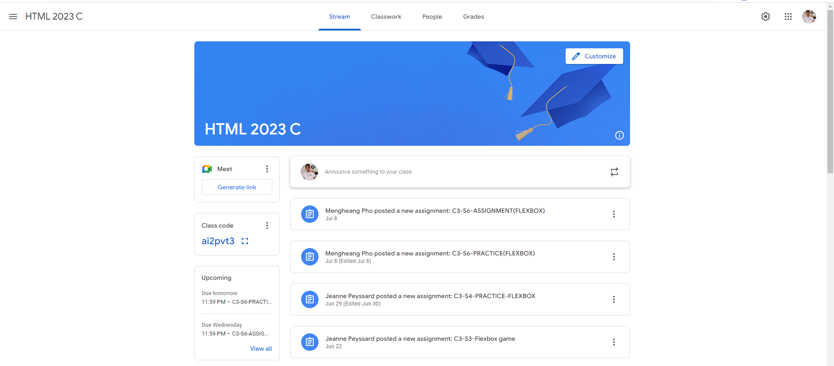
Identify root components of website below

Slide 2
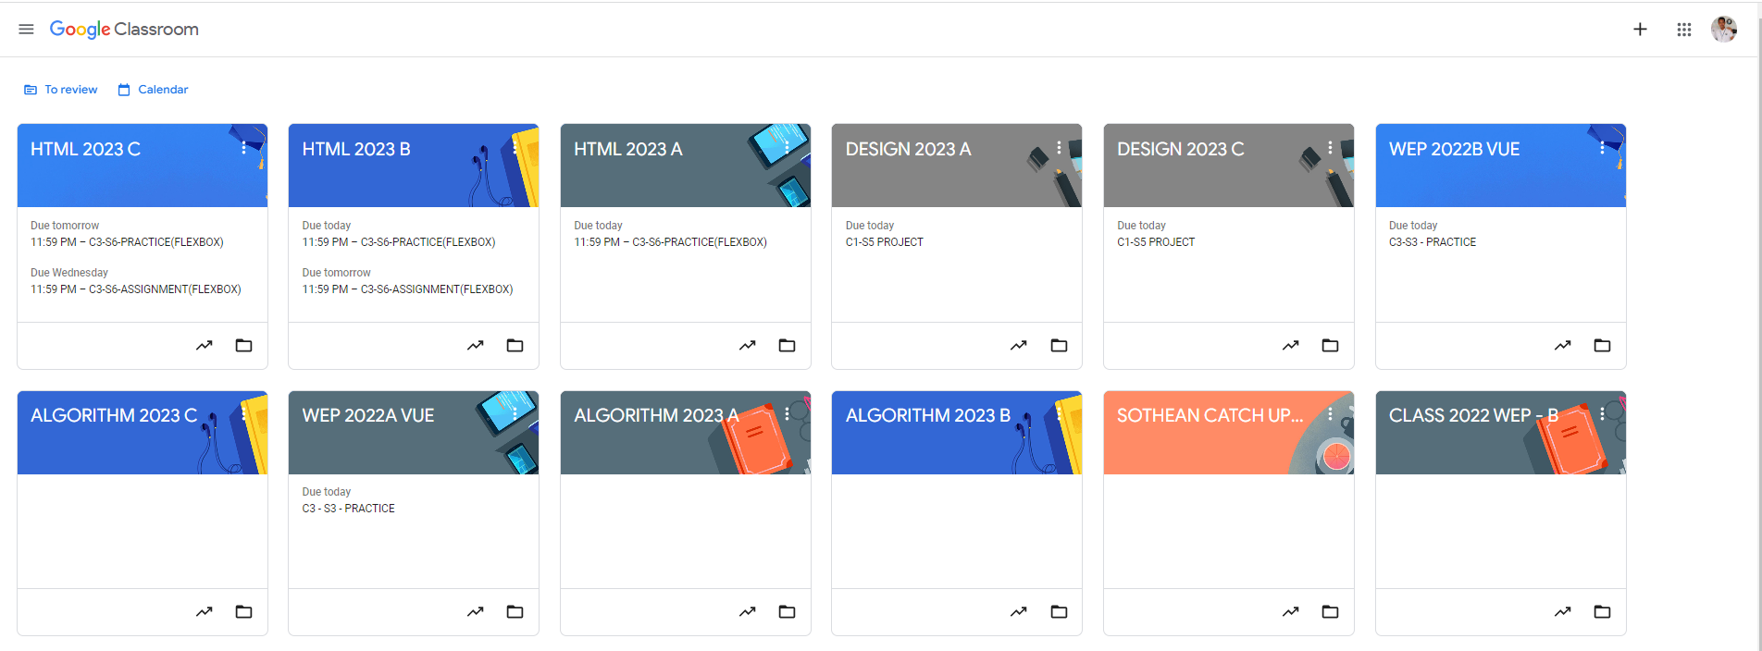
Root div
- Height: 100vh
content
nav
Flex: 0
header
Flex: 0
Flex: 1

Slide 3
header
body
main

Slide 4
Nav-left
Nav-center
Nav-right
a
a
a
a
img
P(text)
Icon
Icon
Icon
Span or div

Slide 5
div1
main
div2
div3

